Slide 1
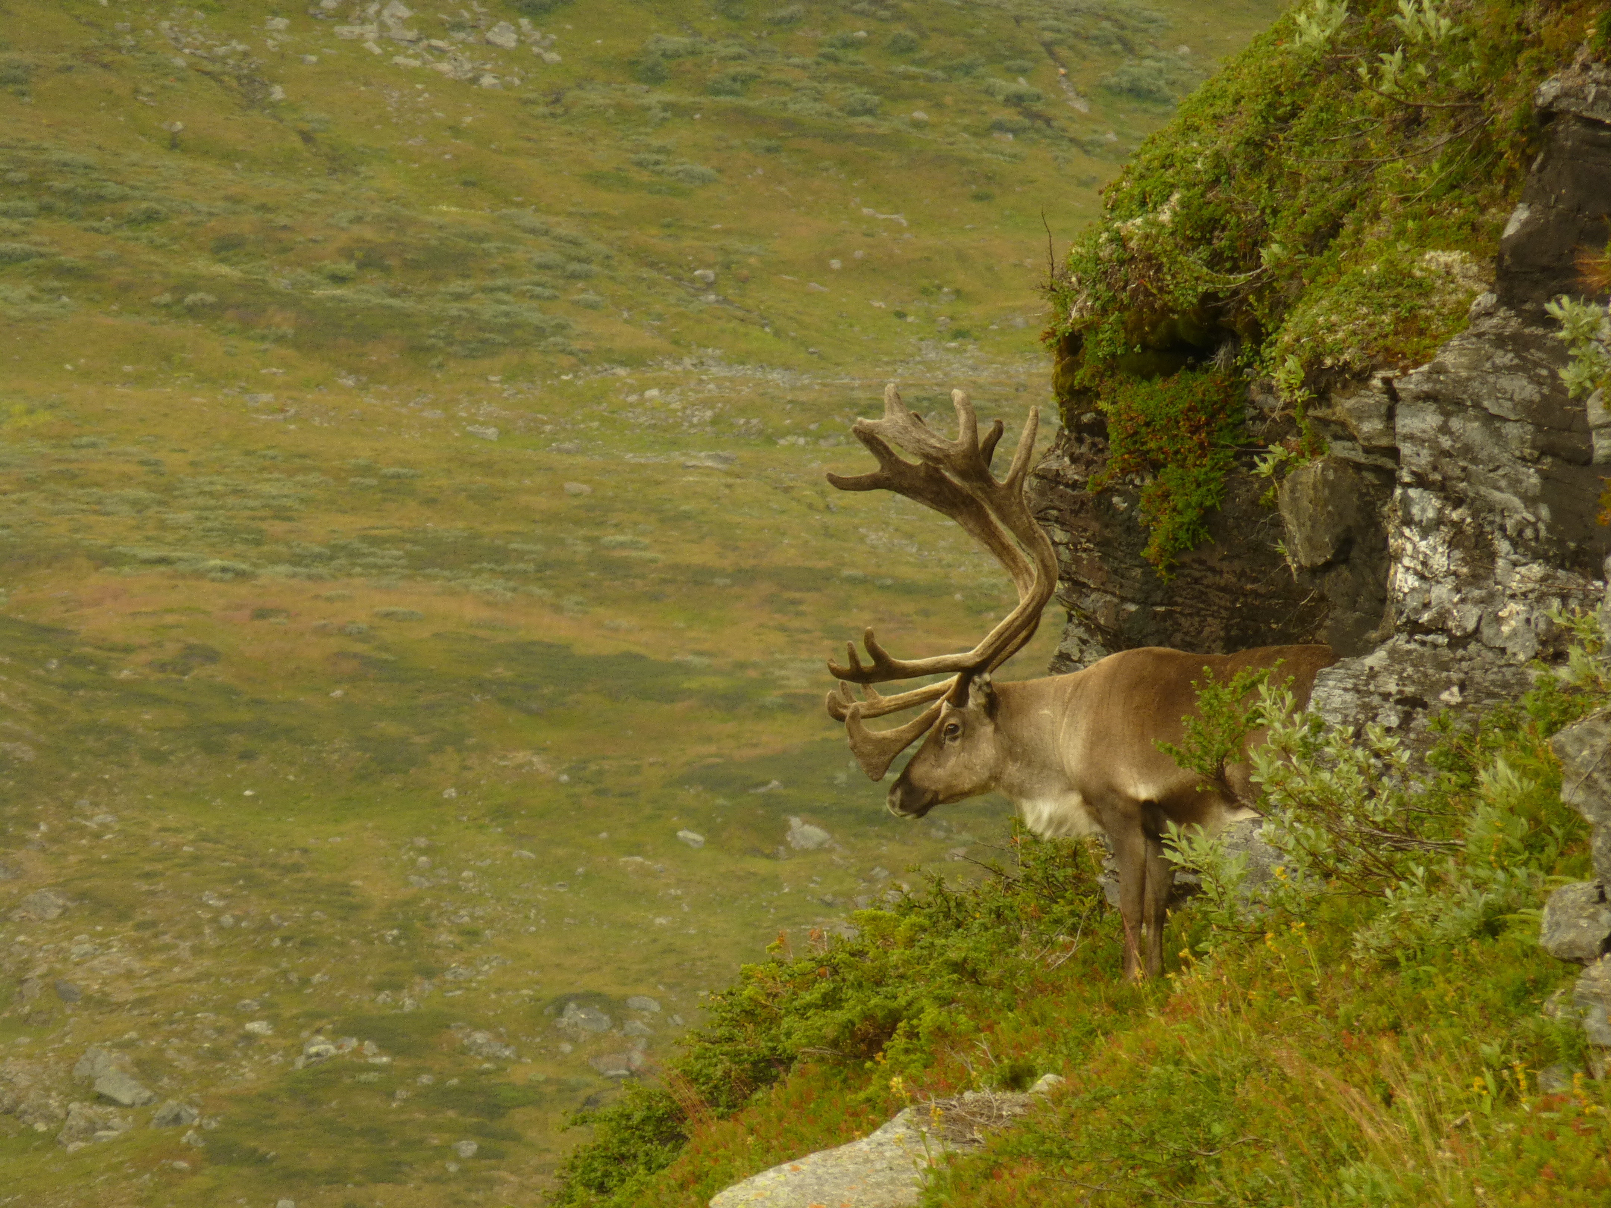
Refugial origins of reindeer (Rangifer tarandus) inferred from mitochrondrial DNA sequences
– Øystein Flagstad & Knut H. Røed –
Evolution 2002
By Sybren J. Hilgen

Slide 2
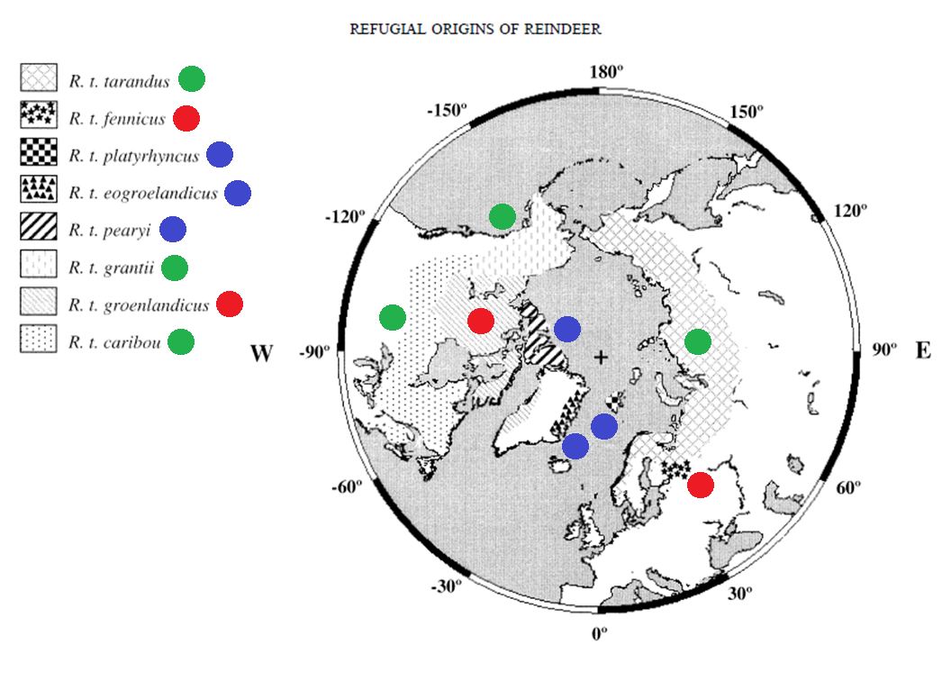
Introduction
What are the effects of large-scale climatic fluctuations on reindeer?
Three morphologically distinct groups of reindeer
Woodland form
Continental form
High arctic island form

Slide 3
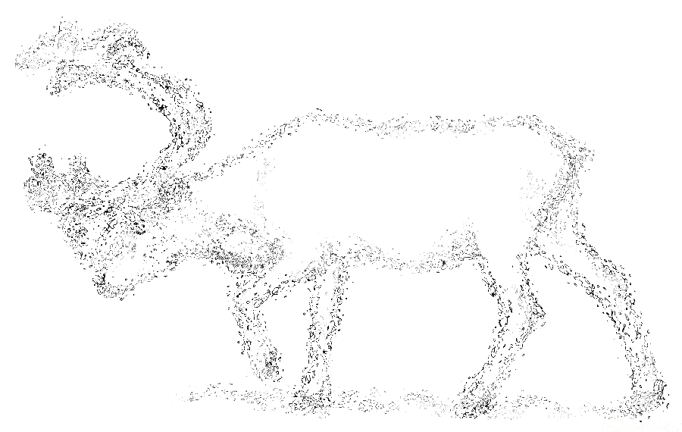
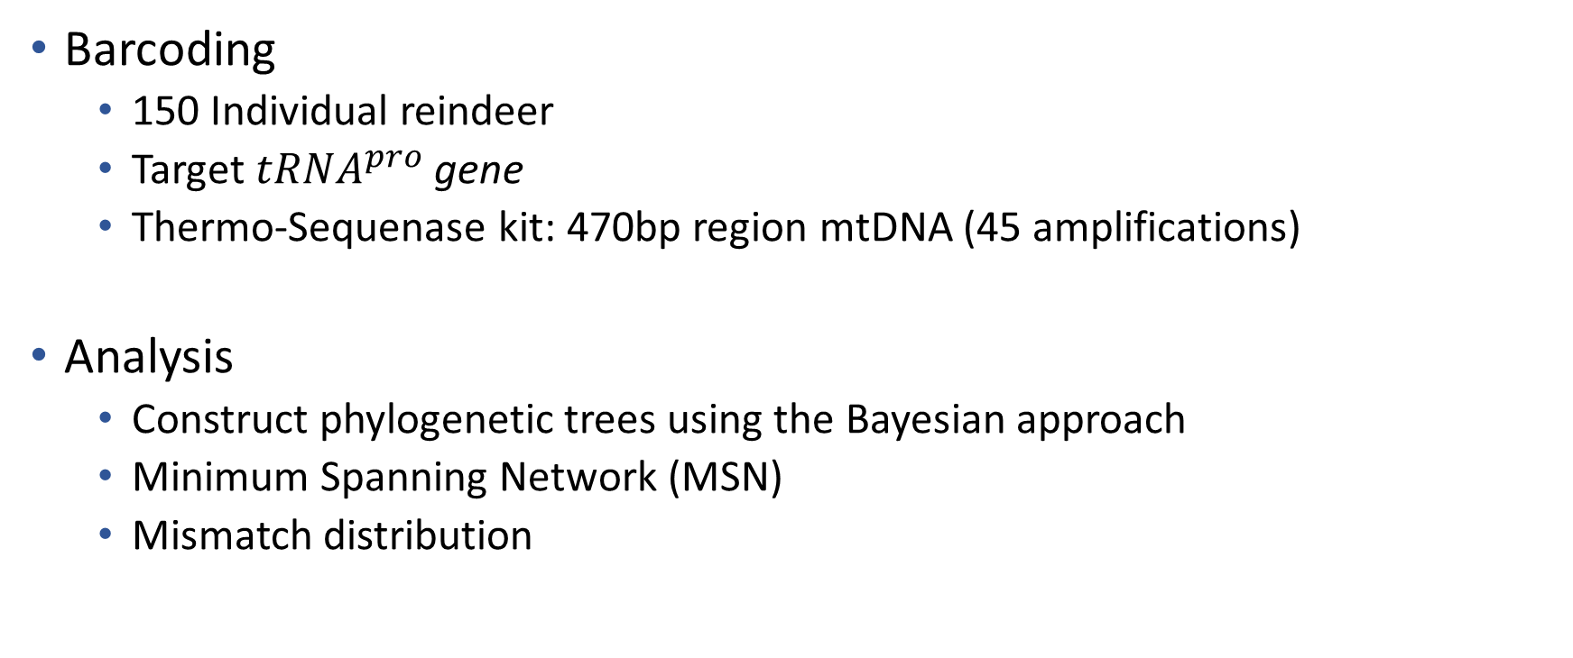
Methods
Barcoding
150 Individual reindeer
Target ${tRNA}^{pro}$ gene
Thermo-Sequenase kit: 470bp region mtDNA (45 amplifications)
Analysis
Construct phylogenetic trees using the Bayesian approach
Minimum Spanning Network (MSN)
Mismatch distribution

Slide 4
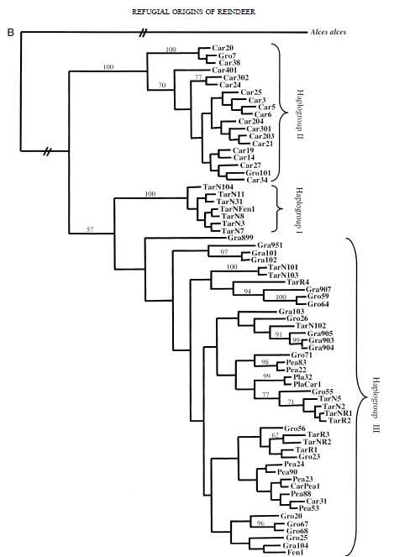
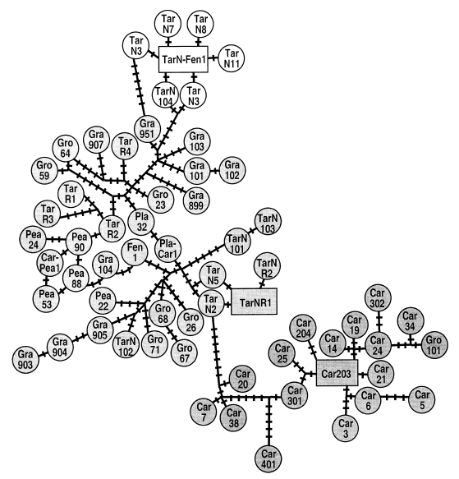
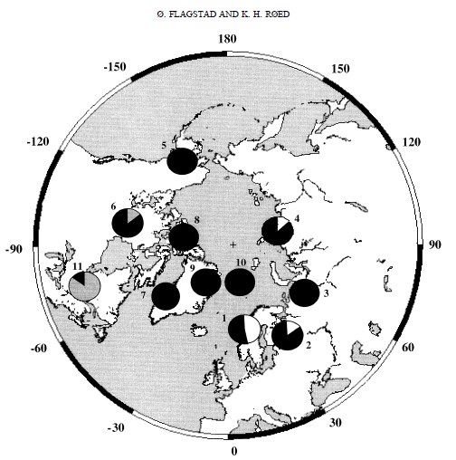
Results
Outgroup: Moose
(Alces alces)
3 Haplotypes
3 Refugia
Minimum spanning network
Clock-constrained tree
(50% of variation explained)
Geographic distribution of the haplotypes

Slide 5
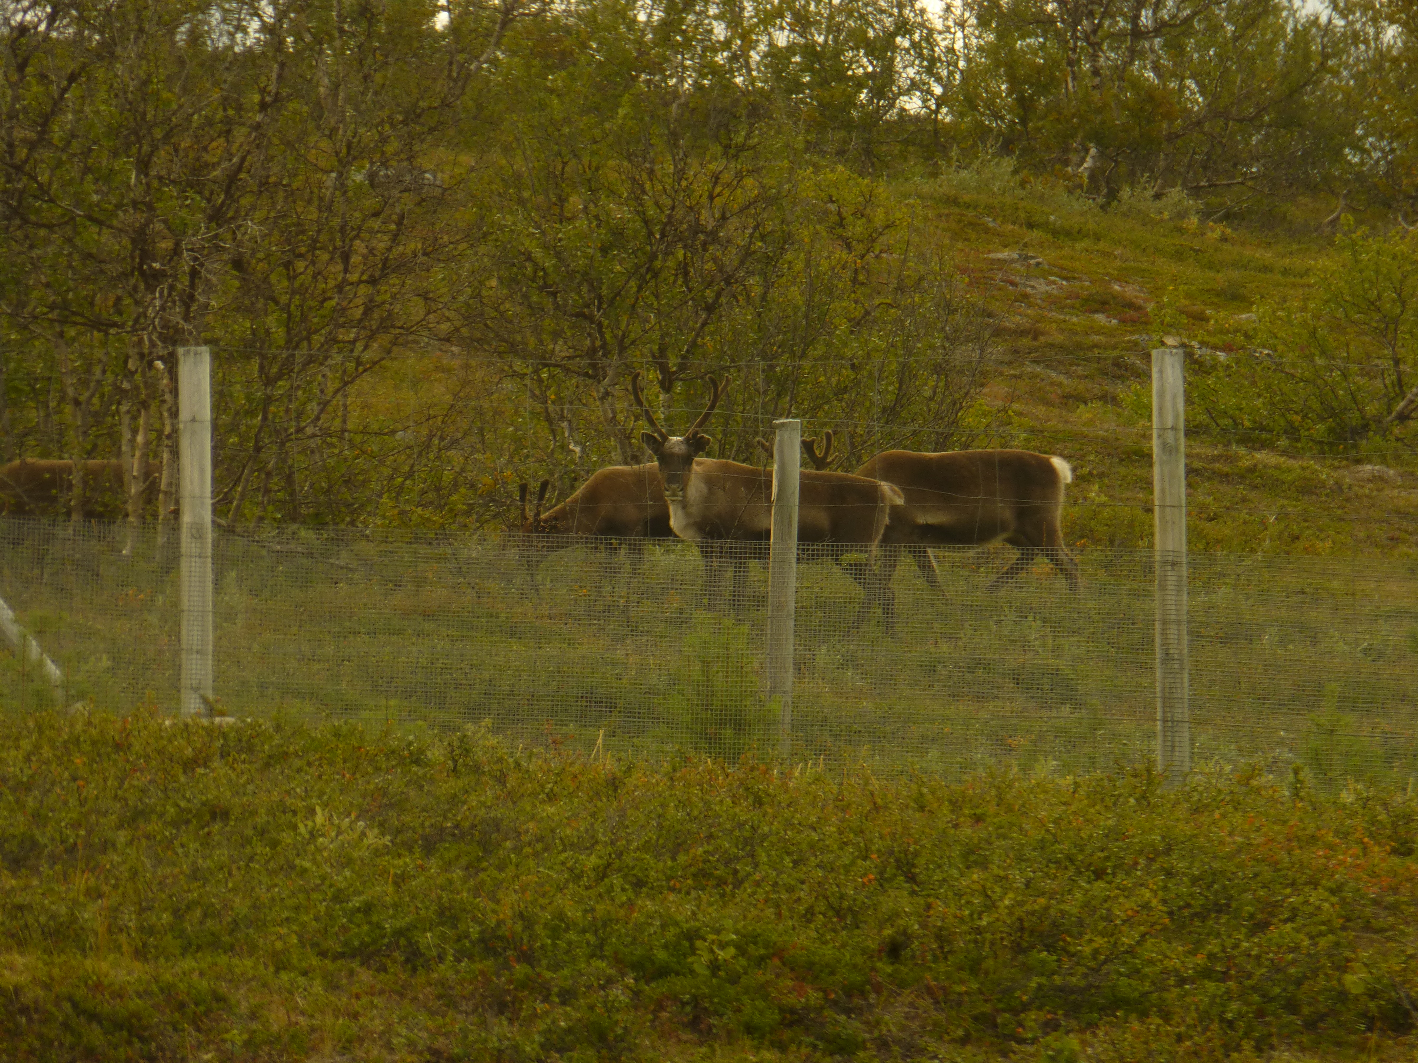
Questions or Comments?

